Slide 1
Electric Vehicle Sales Analysis
Objective: Provide strategic insights to an automotive company for launching electric vehicles (EVs) in the Indian market.
Presented by
Sunitha Madhavadhas

Slide 2
Introduction
AtliQ Motors is an automotive giant from the USA specializing in electric vehicles (EV).
In the last 5 years, their market share rose to 25% in electric and hybrid vehicles segment in North America.
As a part of their expansion plans, they wanted to launch their bestselling models in India where their market share is less than 2%.
Notes:
How presentation will benefit audience: Adult learners are more interested in a subject if they know how or why it is important to them.
Presenter’s level of expertise in the subject: Briefly state your credentials in this area, or explain why participants should listen to you.

Slide 3
Problem Statement
Despite success in the North America , Atliq Motors has a minimal footprint in the Indian Market.
The primary challenge is to analyze the dynamics of the Indian Electric Vehicle (EV) market and pinpoint the key opportunities and potential threats.
Notes:
Lesson descriptions should be brief.

Slide 4
Data View
3 Tables
  dim_date
  Electric_vehicle_sales_by_makers
  Electric_vehicle_sales_by_state
Data consists of sales data for fiscal years 2022,2023,2024

Slide 5
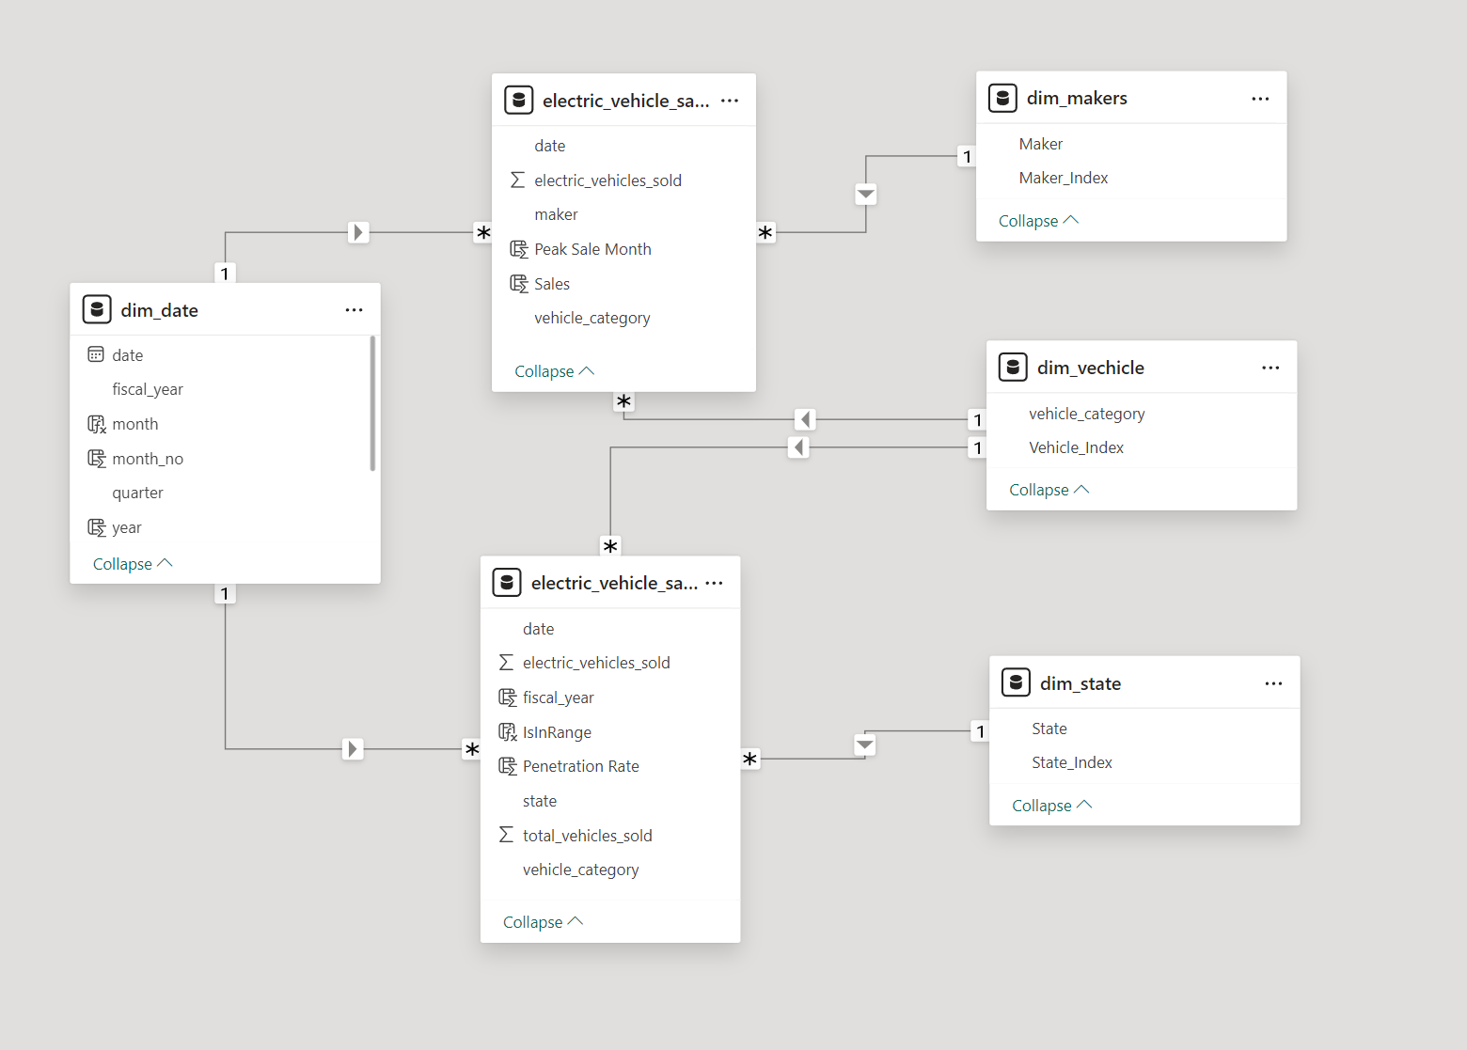
Data Model
Notes:
Example objectives
At the end of this lesson, you will be able to:
Save files to the team Web server.
Move files to different locations on the team Web server.
Share files on the team Web server.

Slide 6
Penetration Rate
This metric represents the percentage of total vehicles that are electric within a specific region or category.
It is calculated as:
Penetration Rate = (Electric Vehicles Sold / Total Vehicles Sold) * 100
This indicates the adoption level of electric vehicles.

Slide 7
CAGR- Compound Annual Growth Rate
CAGR is a measure of the mean annual growth rate of an investment over a specified period of time longer than one year.
It represents one of the most accurate ways to calculate and determine returns for anything that can rise or fall in value over time.
CAGR = (Ending Value/Beginning Value) ^ (1/Number of Years) – 1
Ending Value: The value of the investment at the end of the period.
Beginning Value: The value of the investment at the start of the period.
Number of Years: The total number of years over which the investment is held.

Slide 8
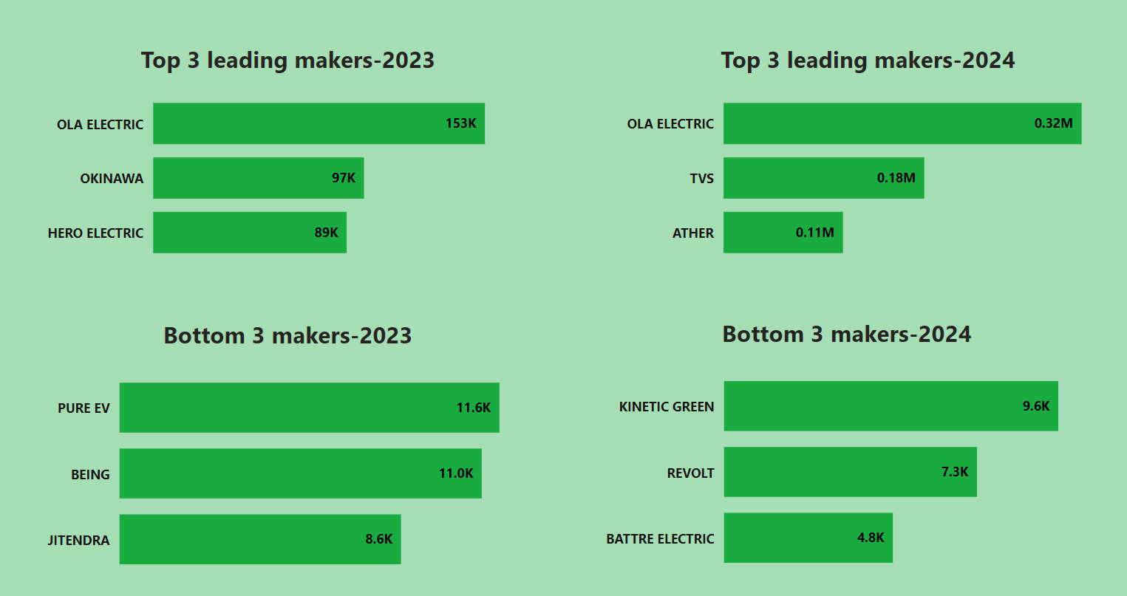
1. List the top 3 and bottom 3 makers for the fiscal years 2023 and 2024 in terms of the number of 2-wheelers sold.
Insights
  It shows which makers are leading and which are facing challenges.
  Helps to decide appropriate positions and plan to compete
  Ola Electric is a leading maker in both 2023 and 2024
  Out of 2 Million Electric vehicles sold , 489K EV vehicle sold by Ola Electric (24.45%)

Slide 9
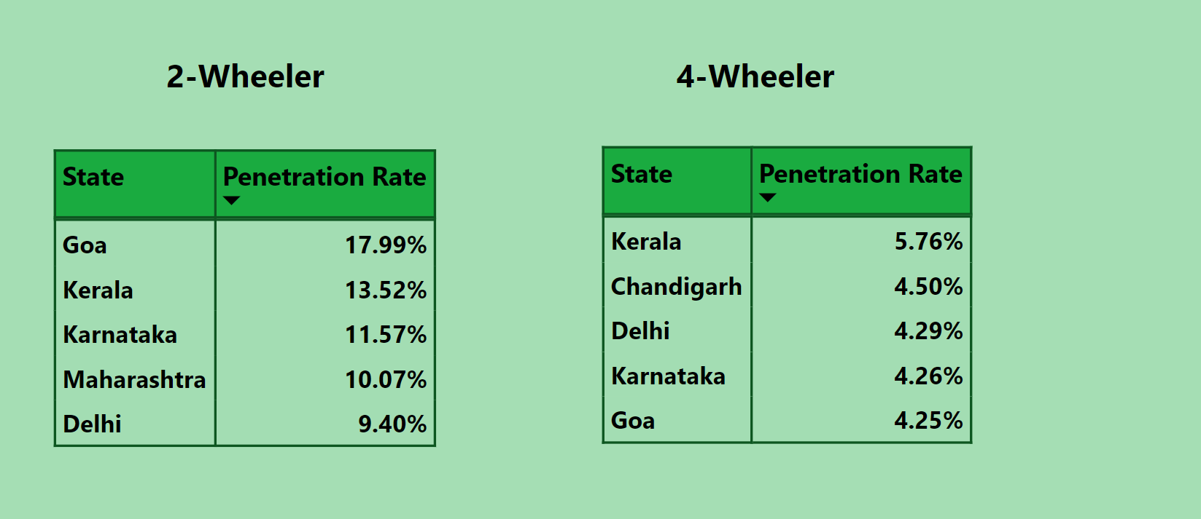
2.Identify the top 5 states with the highest penetration rate in 2-wheeler and 4-wheeler EV sales in FY 2024.
Insights
The ideal state to start business
Which type of vehicle is more favourable
In 2024 , Goa,Kerala,Karnataka,Maharastra and Delhi are the top 5 states for 2wheelers sales
Kerala ,Chandigargh,Delhi,Karnataka,Goa are the top 5 states for 4wheeler sales
Kerala has highest penetration rate in both 2-wheeler and 4-wheeler sale

Slide 10
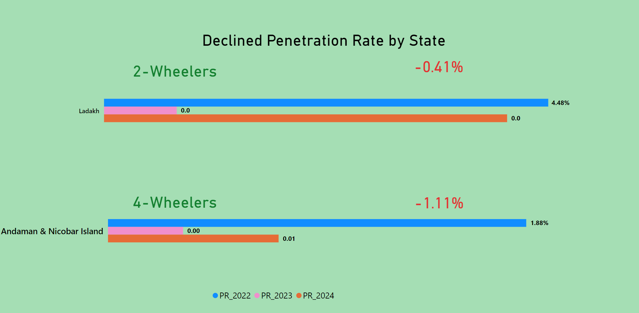
3. List the states with negative penetration (decline) in EV sales from 2022 to 2024?
Insights
  States that are struggling
Ladak has a declining penetration rate(0.41%) in 2 wheelers
Andaman & Nicobar Island has a declining penetration rate (1.11%) in 4 wheelers.

Slide 11
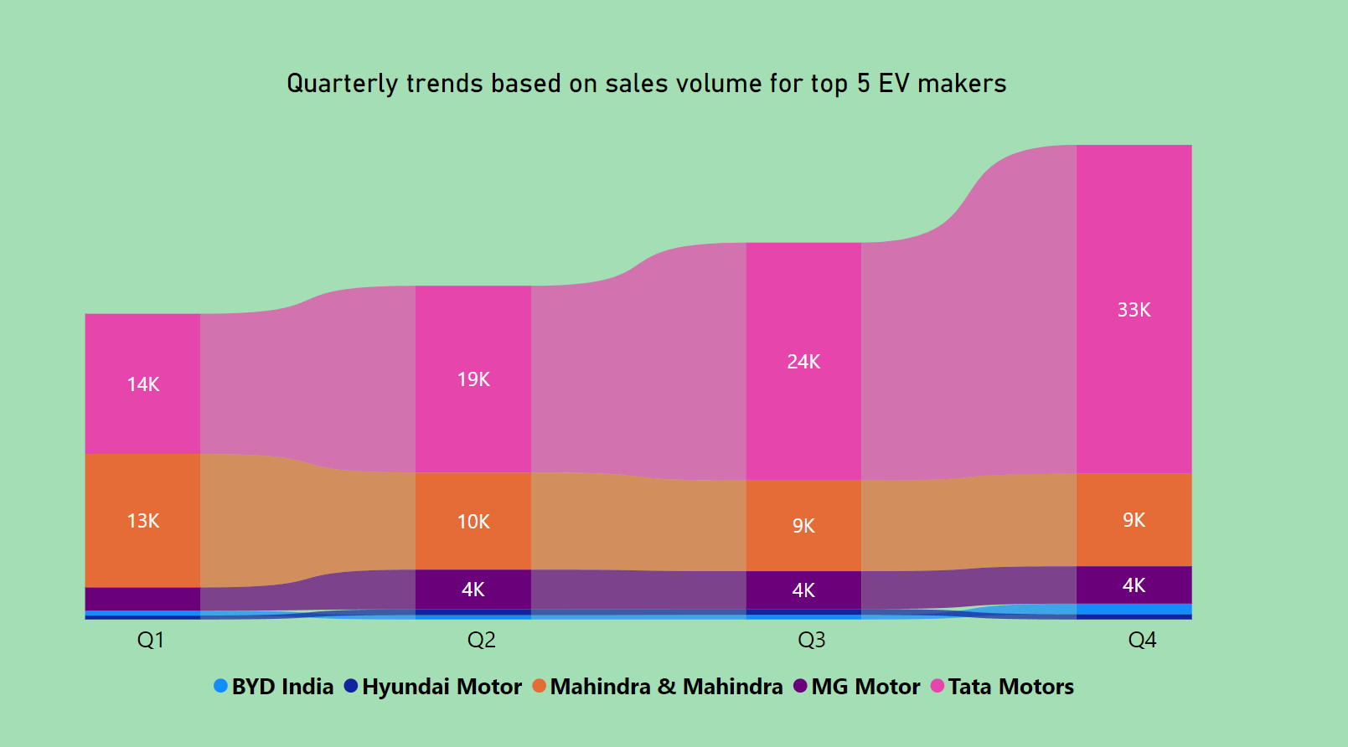
4. What are the quarterly trends based on sales volume for the top 5 EV makers (4-wheelers) from 2022 to 2024?
Insights
  Quarter wise sale for the leading makers
Sales are highest in quarter4 and lowest in quarter1
Tata motors has a significant increase in every quarter and leads in every quarter
BYD India and Hyundai Motor sold fewer in each quarter

Slide 12
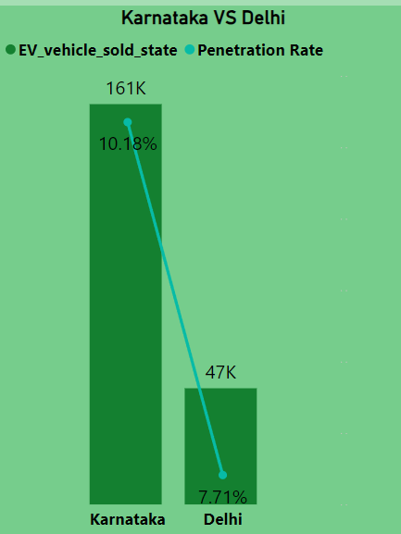
5. How do the EV sales and penetration rates in Delhi compare to Karnataka for 2024?
Karnataka leads in terms of electric vehicle sale and penetration rate.
Karnataka's sales were four times higher than Delhi’s
The penetration rate for both states are nearly same.
Delhi – 7.71%
Karnataka – 10.18%

Slide 13
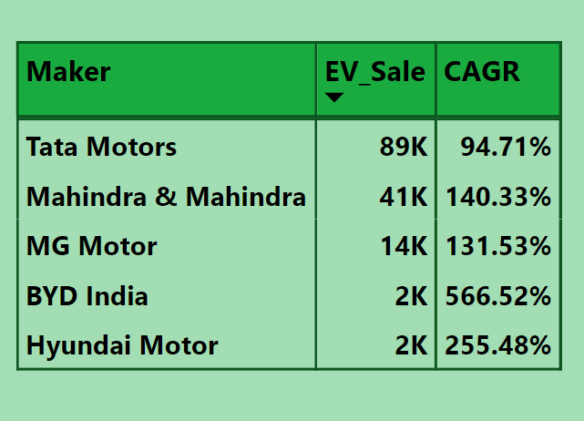
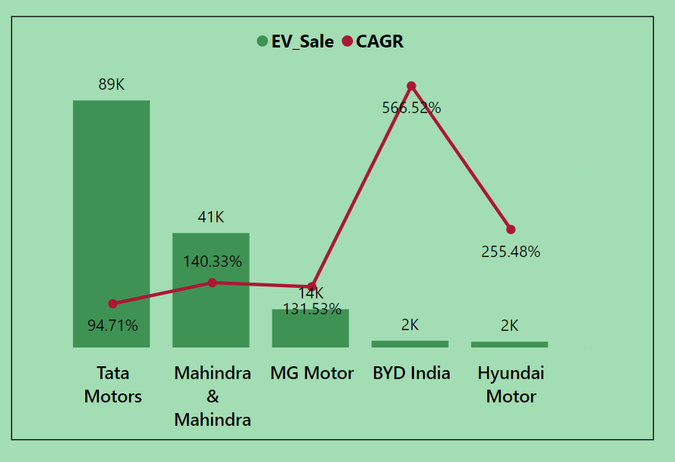
6. List down the compounded annual growth rate (CAGR) in 4-wheeler units for the top 5 makers from 2022 to 2024.

Slide 14
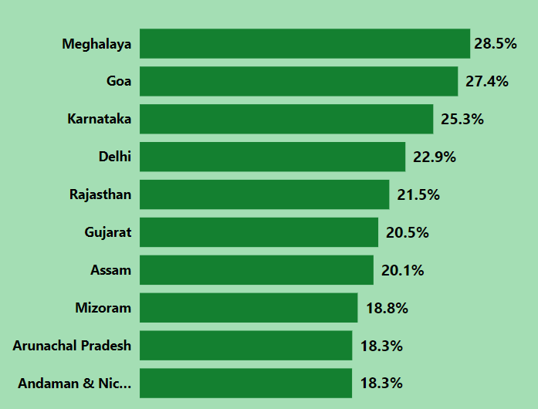
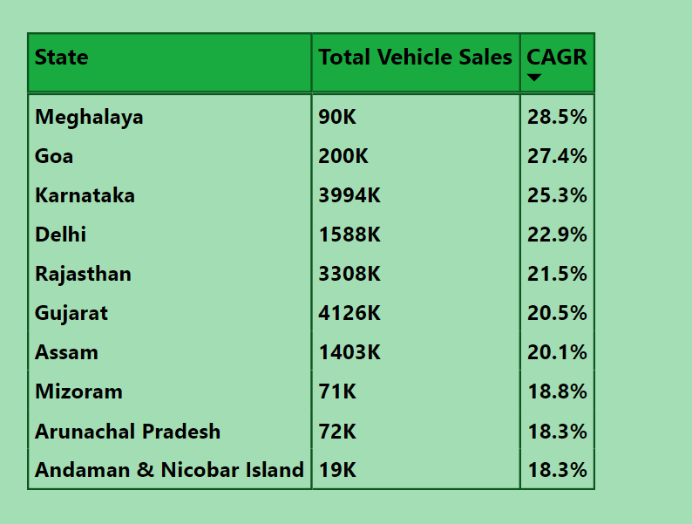
7. List down the top 10 states that had the highest compounded annual growth rate (CAGR) from 2022 to 2024 in total vehicles sold.

Slide 15
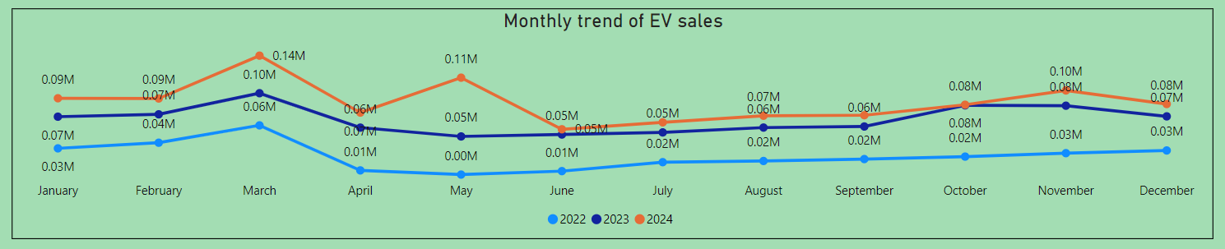
8. What are the peak and low season months for EV sales based on the data from 2022 to 2024?
Peak Season - March
Low season – June

Slide 16
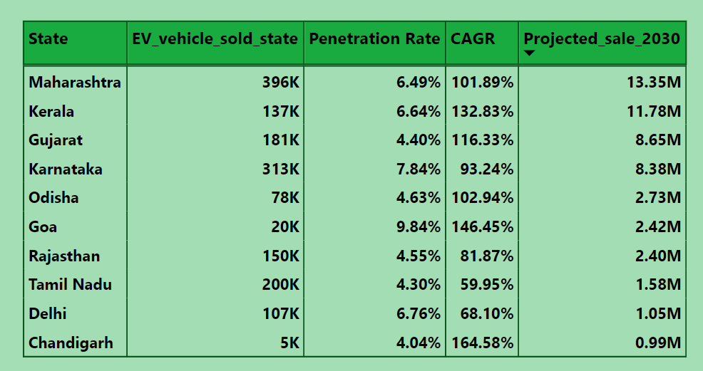
9. What is the projected number of EV sales (including 2-wheelers and 4 wheelers) for the top 10 states by penetration rate in 2030, based on the compounded annual growth rate (CAGR) from previous years?
Maharashtra has the highest predicted sale of 13.35M by 2030.

Slide 17
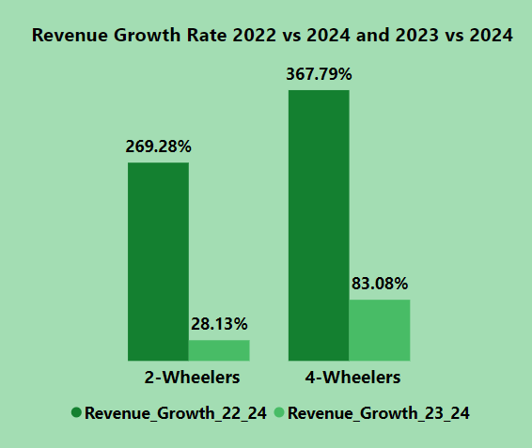
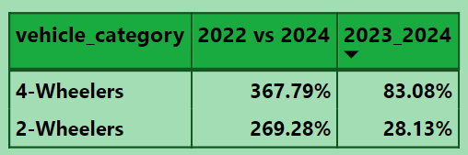
10.Estimate the revenue growth rate of 4-wheeler and 2-wheelers EVs in India for 2022 vs 2024 and 2023 vs 2024, assuming an average unit price. 2-Wheelers :85,000 INR; W-Wheelers: 15,00,000 INR
A 2-wheeler typically costs 85,000 INR
For 2 wheelers, growth rate has increased by 269% between 2022 and 2024 but only increased 28% between 2023 and 2024.
A 4-wheeler typically costs 15,00,000 INR
For 4 wheelers, growth rate has increased by 368% between 2022 and 2024 but only increased 83% between 2023 and 2024.

Slide 18
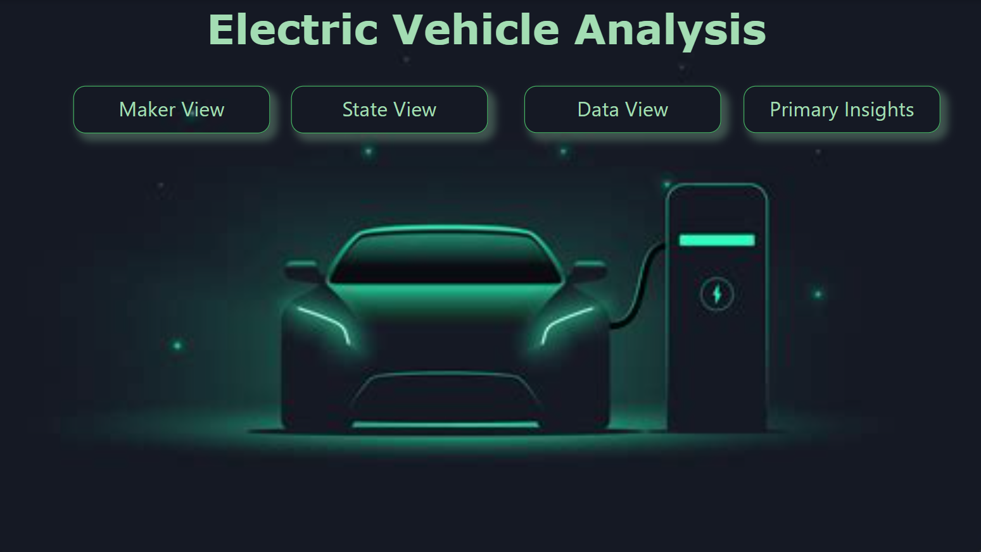
PowerBI Report

Slide 19
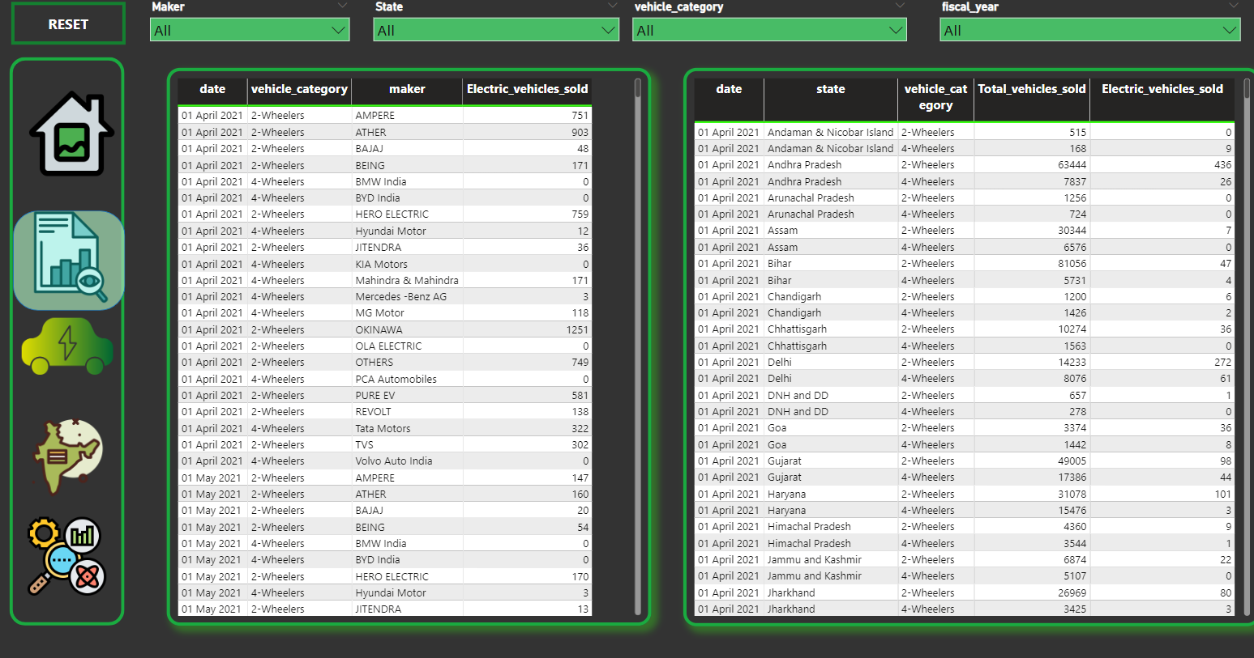
Data View

Slide 20
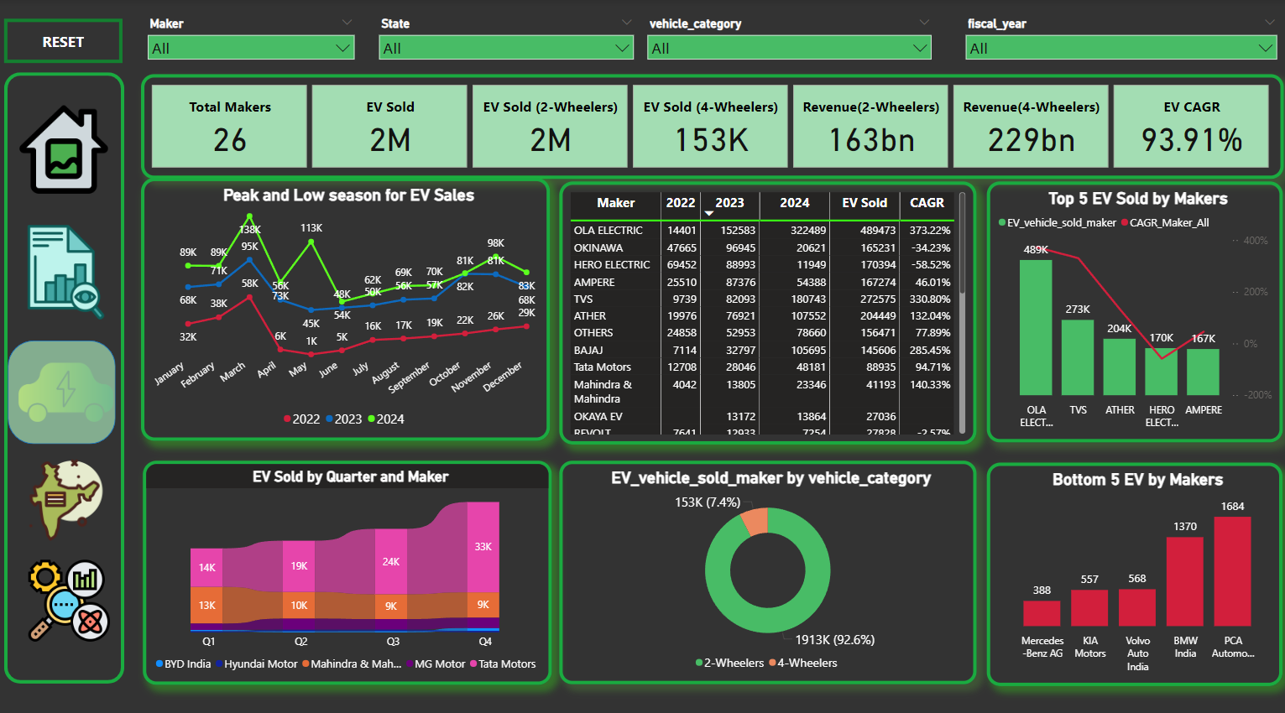
Maker View

Slide 21
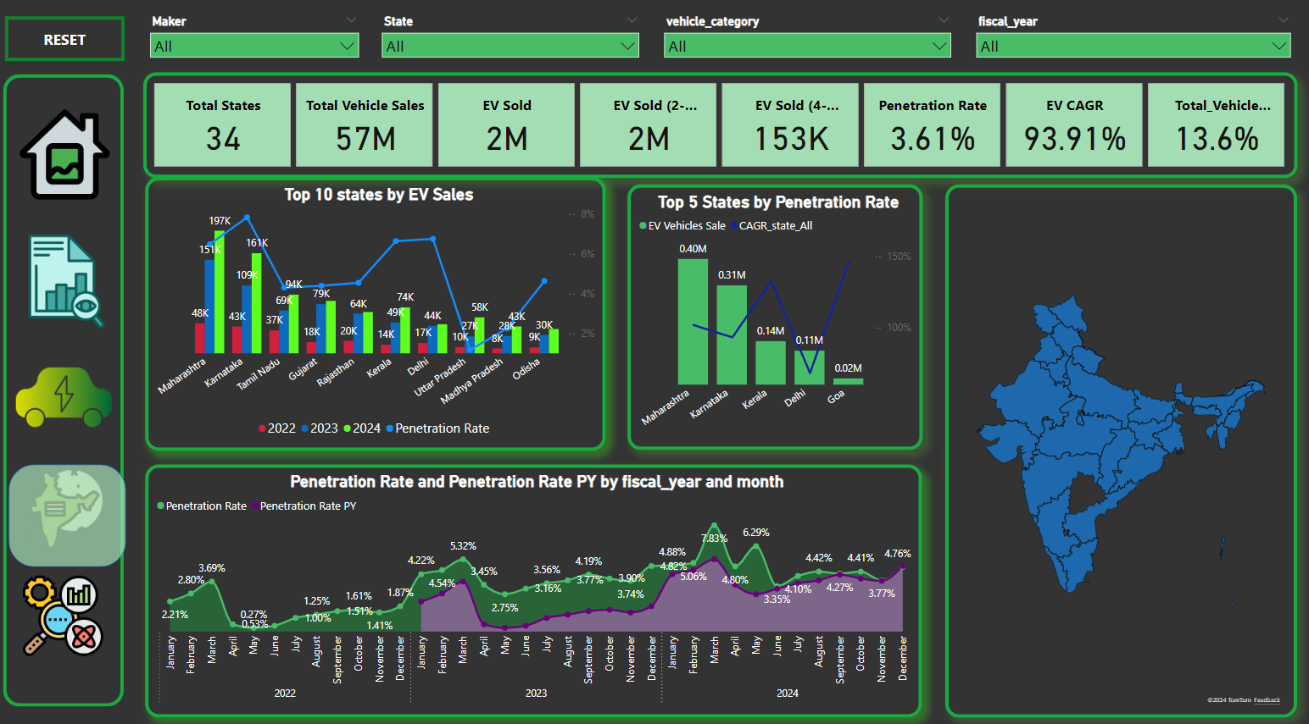
State View

Slide 22
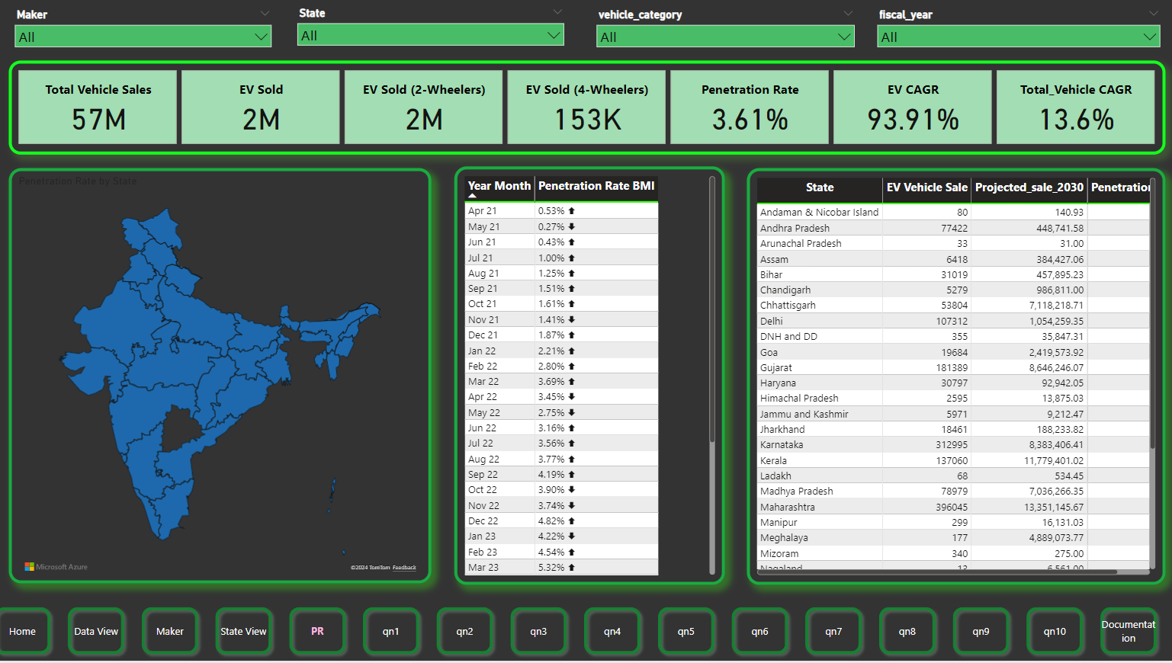
Penetration Rate View

Slide 23
Secondary Research Questions

Slide 24
1. What are the primary reasons for customers choosing 4-wheeler EVs in 2023 and 2024 (cost savings, environmental concerns, government incentives)?
Cost Savings
  Lower Operating cost
  Long term serving
  Less maintenance
Environmental Concerns
  Reduced carbon footprint
  Zero Emissions
  Sustainability
Government Incentives
  Tax benefits
  Faster registration and permits

Slide 25
2.How do government incentives and subsidies impact the adoption rates of 2-wheelers and 4-wheelers? Which states in India provided most subsidies?
Reduction in Upfront Costs: Subsidies reduce the overall cost of vehicles, especially electric vehicles (EVs), which are often priced higher than their internal combustion engine (ICE) counterparts due to the high cost of batteries. This makes 2-wheelers and 4-wheelers more affordable to a wider range of consumers.
  2-wheelers: The subsidy significantly impacts electric 2-wheeler adoption because they are generally more affordable and popular in countries like India for short-distance travel. Lower prices attract the mass market.
  4-wheelers: For electric 4-wheelers, the reduction in upfront costs also makes them a more competitive option compared to petrol and diesel cars.
Lower Total Cost of Ownership (TCO): Subsidies for EVs, including tax incentives, rebates, or direct subsidies on vehicle purchases, help reduce the total cost of ownership by lowering both the initial purchase price and operating costs (such as fuel and maintenance).
Creation of Charging Infrastructure: Governments often couple financial subsidies with investments in EV infrastructure like public charging stations. This encourages consumer confidence in purchasing EVs by reducing range anxiety, which is a significant barrier to EV adoption, especially for 4-wheelers.
Market Confidence and Innovation: By signaling government support for electric mobility, subsidies encourage automakers to invest in the production of electric vehicles. This leads to technological improvements, cost reductions, and innovation in battery technology, driving further adoption.
Consumer Awareness and Policy Stability: Subsidies often come along with awareness campaigns, which help educate consumers on the benefits of EVs. Predictable and long-term incentives help boost confidence in making the switch to electric vehicles.

Slide 26
States Providing the Most Subsidies for EVs
Delhi:
  Offers up to ₹30,000 subsidies for 2-wheelers and ₹1.5 lakh for 4-wheelers.
  Free registration and road tax for EVs.
Maharashtra:
  Provides significant incentives for electric 2-wheelers, 3-wheelers, and 4-wheelers.
  Offers subsidies of up to ₹10,000 for 2-wheelers and ₹1.5 lakh for electric 4-wheelers, with additional early-bird benefits for purchases made before a specific deadline.
  Also promotes EV infrastructure development.
Gujarat:
  Offers up to ₹20,000 subsidy for electric 2-wheelers and ₹1.5 lakh for 4-wheelers.
  The state aims to make EVs more affordable to the middle class by further incentivizing vehicle purchases.
Tamil Nadu:
  Focuses on creating an EV manufacturing hub and provides substantial support in terms of infrastructure and subsidies.
  Exemptions from road tax, registration fees, and investment in charging stations.
Karnataka:
  Among the first states to adopt a comprehensive EV policy.
  Offers exemptions from road tax and registration fees.
  Focuses on attracting investment in EV manufacturing and infrastructure.
Telangana:
  Provides subsidies for EV buyers and incentivizes the development of EV charging infrastructure.
  Exemption from road tax and registration for the first few lakh EVs sold in the state.
Rajasthan:
  Offers a state-level subsidy on electric 2-wheelers and 4-wheelers.
  Focus on promoting rural and semi-urban EV adoption by improving charging infrastructure.

Slide 27
3.How does the availability of charging stations infrastructure correlate with the EV sales and penetration rates in the top 5 states in India?
The correlation between the availability of charging station infrastructure and EV sales/penetration rates in the top states is significant, though it's still developing as the country works towards broader EV adoption.
Maharashtra:
  Maharashtra has prioritized building public charging stations, especially in major cities. With plans to install thousands of new chargers by 2025, the infrastructure is gradually catching up to demand. The state government has also implemented policies to promote private charging stations in residential and commercial buildings.
  An increasing number of chargers, especially in urban areas, has supported the growth of EV sales. However, rural areas still lag, and more chargers are needed .
Karnataka:
  Bengaluru has one of the better-developed charging infrastructures in India, with the Karnataka government promoting both public and private chargers. There are over 600 charging stations, and the state plans to set up more to cater to the increasing demand.
  Karnataka, particularly Bengaluru, is a hub for EV startups and sees high EV penetration, especially in two-wheeler and electric taxi segments.
Kerala:
  Kerala has been experiencing a steady rise in EV adoption, particularly in the two-wheeler and three-wheeler segments.
  Kerala is still in the early stages of developing a comprehensive EV charging network. As of 2023, Kerala had installed around 150-200 public charging stations across the state, with the majority being located in major urban areas.
  The government has announced plans to install more than 1,000 charging stations by 2025 as part of its EV policy
Delhi:
  Delhi has one of the highest EV penetration rates in India, largely due to strong government subsidies and policy support
  Delhi has made significant strides in installing public and private charging infrastructure. The city has a growing network of over 1,500 charging points as of 2023, with plans to expand further.
Goa:
  EV penetration in Goa is relatively low compared to other states like Delhi or Maharashtra, but it's growing.
  The number of public charging stations in Goa is still limited, with around 50-60 charging points as of 2023.
  Goa has ambitious plans to expand its charging infrastructure, aiming to install 50 new public charging stations by 2025 in partnership with private players.

Slide 28
4. Who should be the brand ambassador if AtliQ Motors launches their EV/Hybrid vehicles in India and why?
When selecting a brand ambassador for AtliQ Motors’ EV/Hybrid vehicles in India, the ideal candidate should resonate with the company’s vision, embody sustainability, innovation, and appeal to a wide audience. The ambassador should also have a credible and positive image, be aligned with eco-friendly initiatives, and have a strong influence among both younger and aspirational segments.
    Virat Kohli (Cricketer)
      Kohli has been vocal about leading an environmentally friendly lifestyle, which aligns with the ethos of electric vehicles and sustainability.
      His broad appeal across India, combined with a sharp focus on fitness and modern technology, makes him an ideal candidate to endorse an eco-conscious, high-performance brand like AtliQ Motors.
    Deepika Padukone (Actress and Mental Health Advocate):
      Deepika has spoken out about various social causes and is a known advocate for mental health and sustainability. She represents a balanced lifestyle that aligns well with the environmental benefits of EVs.
      Her influence goes beyond just Bollywood. She’s seen as a trendsetter and having her as a face of AtliQ Motors would bring credibility and aspirational value to the brand, appealing to both men and women.
    Sundar Pichai (CEO of Google)
      Having Sundar Pichai, a global technology leader of Indian origin, as a brand ambassador would connect AtliQ Motors with the high-tech, forward-thinking, and urban demographic. His involvement in tech innovations, including Google's focus on sustainability, aligns with the green future of EVs.
      Pichai’s Indian roots and global success make him relatable and aspirational to young Indian professionals who see electric vehicles as the future of urban mobility.

Slide 29
5. Which state of India is ideal to start the manufacturing unit? (Based on subsidies provided, ease of doing business, stability in governance etc.)
Maharashtra is considered as the most ideal state for establishing the AtliqMotors manufacturing unit.
Subsidies: Maharashtra has a very attractive EV policy that includes financial incentives for manufacturers, such as capital subsidies, interest subsidies, and tax exemptions. For example, manufacturers can receive benefits on SGST reimbursements, stamp duty exemptions, and a power tariff subsidy.
Ease of Doing Business: Maharashtra ranks highly on India’s Ease of Doing Business (EoDB) rankings. The state provides a relatively straightforward process for setting up industrial units, including single-window clearances and support for project approvals.
Infrastructure: The state has well-developed infrastructure, including Mumbai's port, international connectivity, and industrial clusters like Pune, Aurangabad, and Nagpur. These hubs are known for automobile and engineering industries, providing access to skilled labor and supply chains.
EV-Specific Focus: The state has plans to become a key hub for EV production with focused policies that support the growth of this sector.

Slide 30
6. Top 3 recommendations for AtliQ Motors.
Choose Maharashtra for Manufacturing Operations
Leverage Government Subsidies and Incentives
Focus on Building a Robust EV Ecosystem

Slide 31
Thank you

